Slide 1


PROJECT PRESENTATION
Team: aficionados

Slide 2
AIR POLLUTION
One of the biggest challenge to be handled at the moment

Slide 3

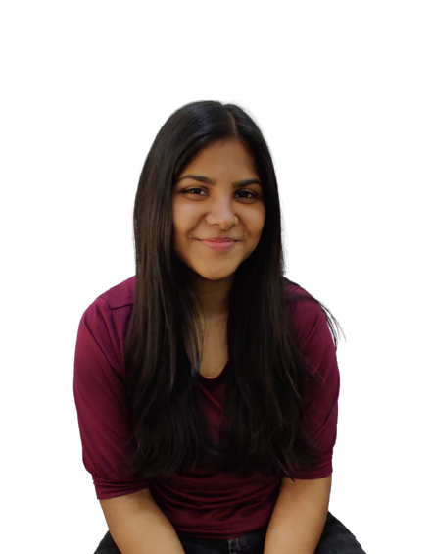




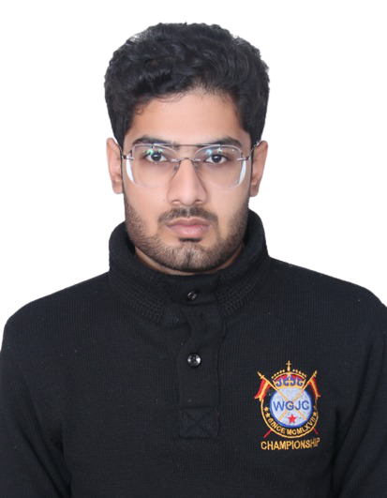

Team: together everyone achieves more
Anmol sharma
Team leader, assembler
vidushi
Presenter, data curator
shubhanshi
Presenter, data visualizer
Raghav sharma
Ml model, visual
Abhinav Saxena
Data cleaner, visualizer
Maulik varshney
Data visualizer
Abhishek mittal
content
Mr. Abhishek Ratnakar singh sir
mentor

Slide 4
Roadmap
Data Collection/ Gathering
Data Visualization/ Infographical analysis
Model Training Phase
1
3
5
2
4
6
Data Cleaning/ Wrangling
Collecting Insights
Time for final Results

Slide 5
Leading causes
Industrial emission
Unplanned Transportation
Metrological conditions
Deforestation
Overuse celebration festivals

Slide 6
How to approach the problem?
Data
We can deal with the problem by confining our research to the most relevant data for the same.
In our case we found AQI can serve the best results.
Analysis
With proper tools and accurate data, comes refined results.
Here we will work on data related to AQI and it’s various dependent parameters for analysis.

Slide 7
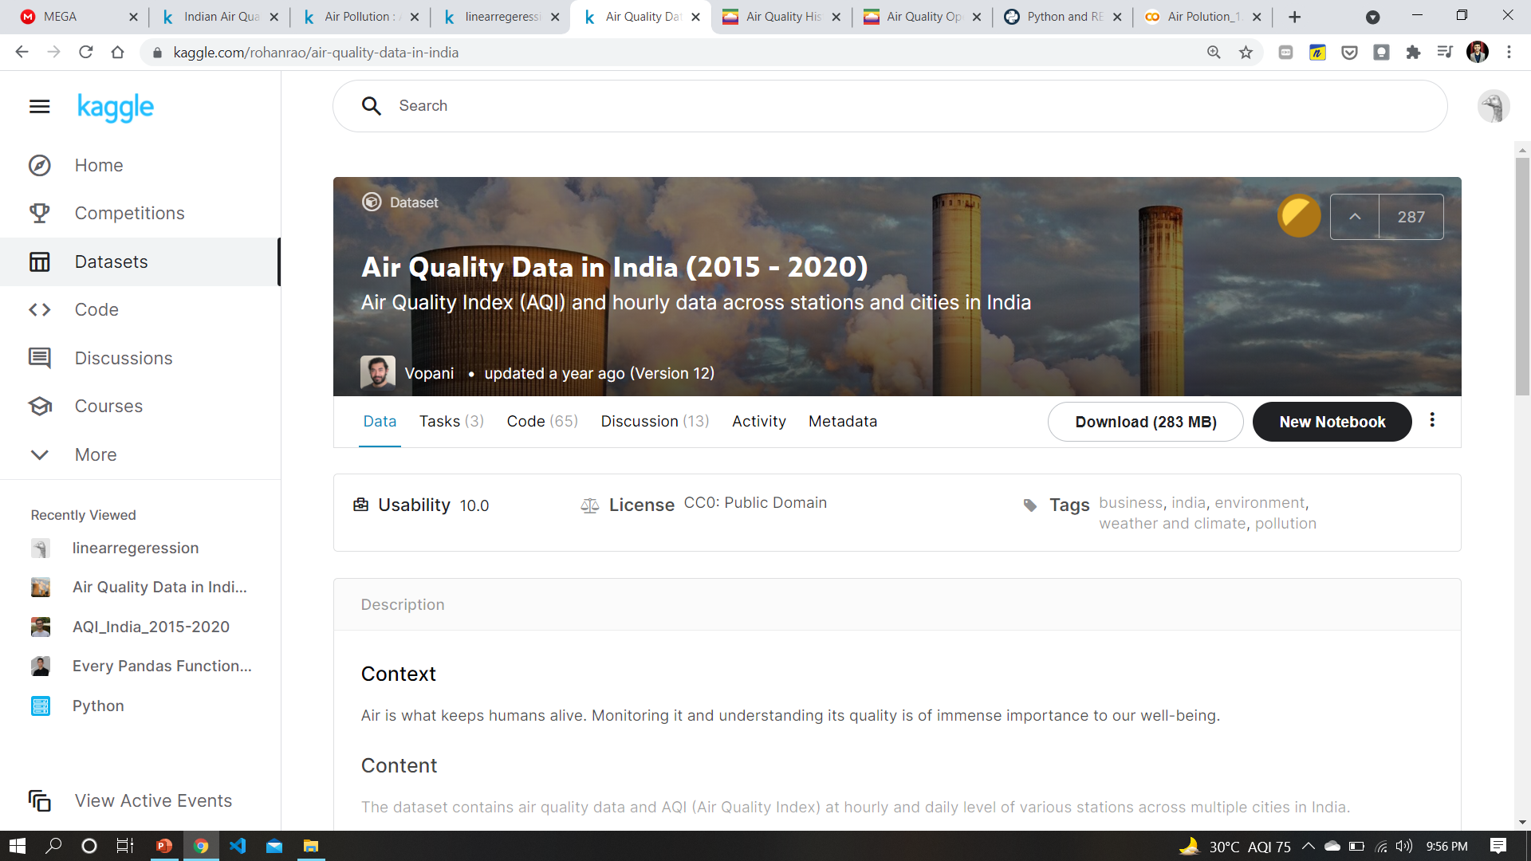
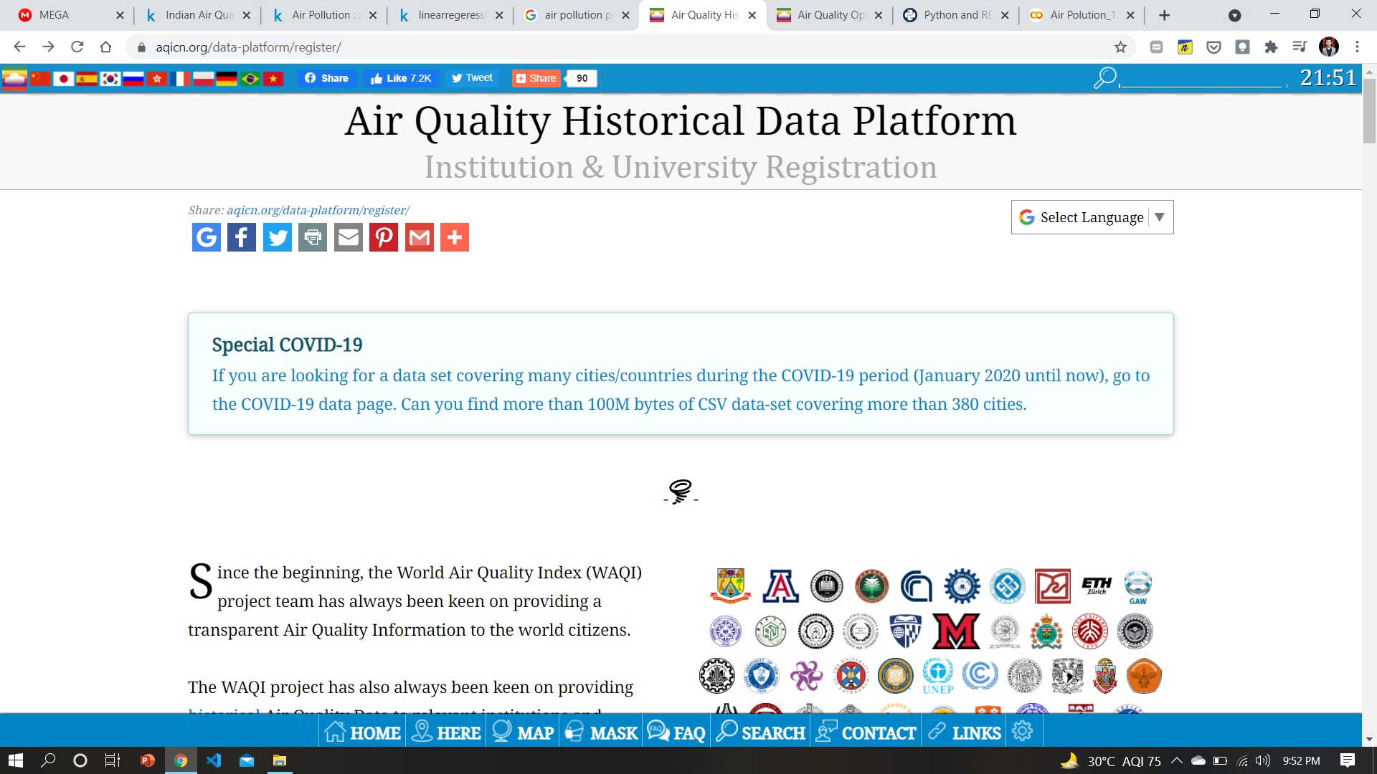
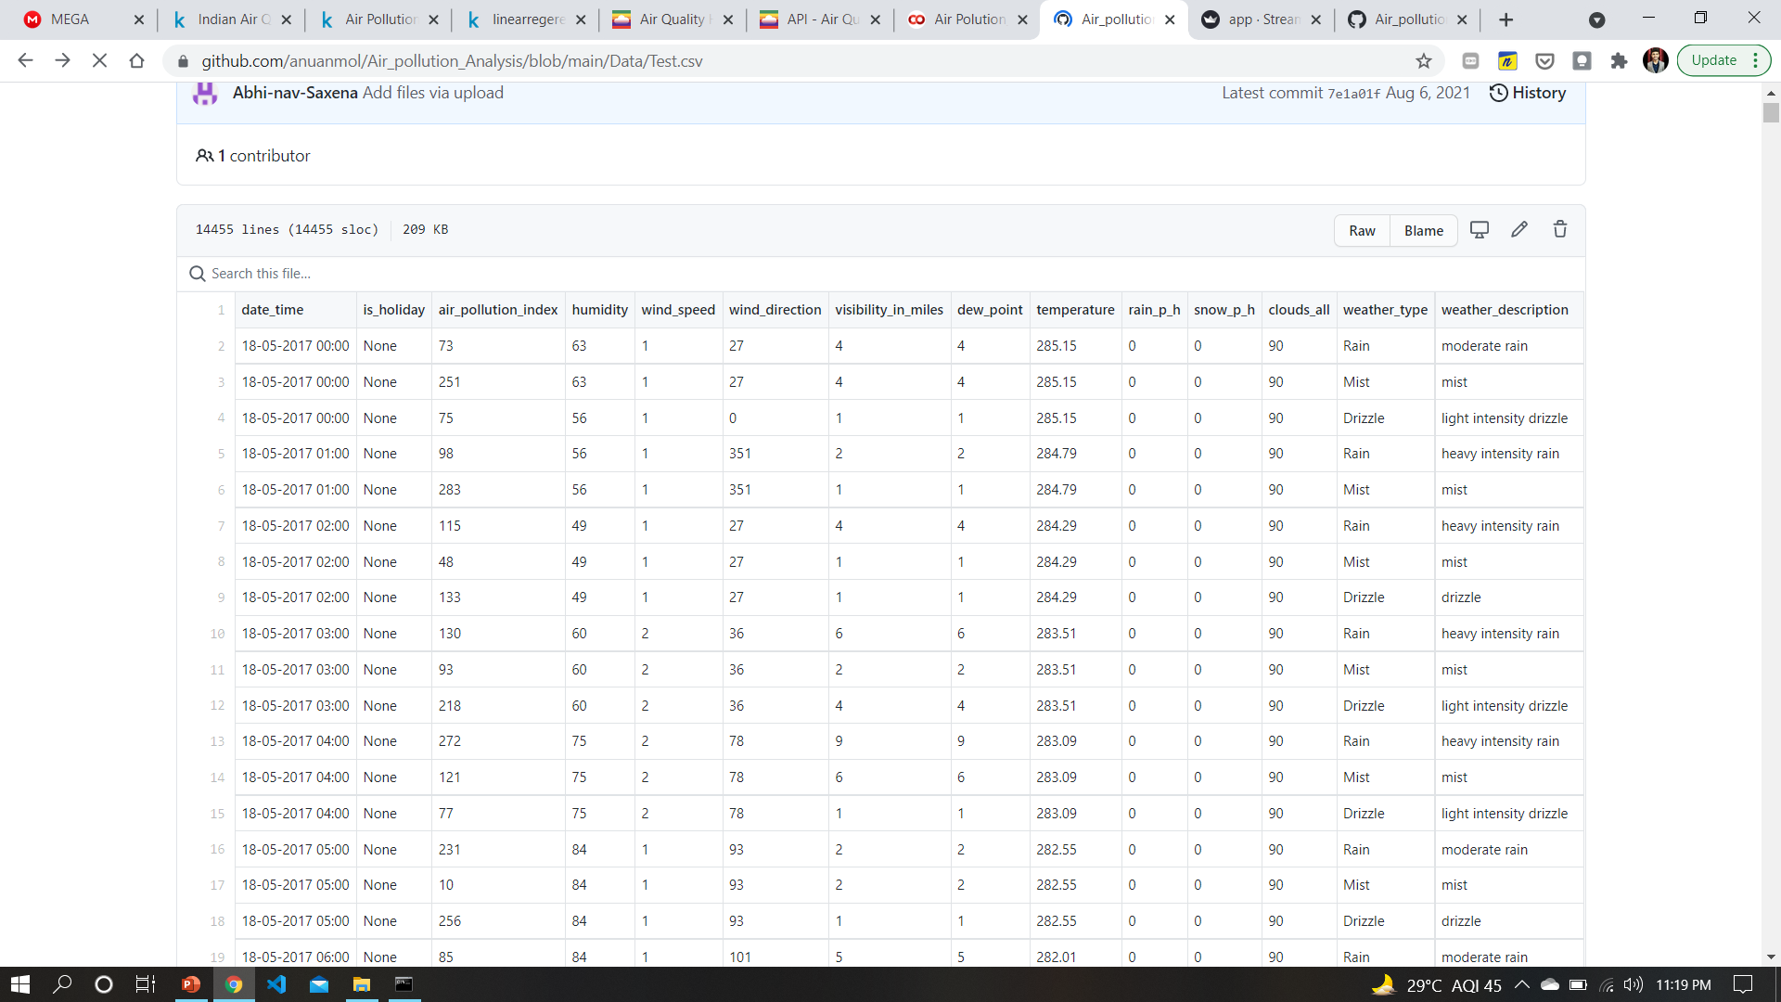
Where we got our DATA from?
1. Kaggle Datasets
2. Air Quality Historical Data Platform
3. Metrological Data →

Slide 8
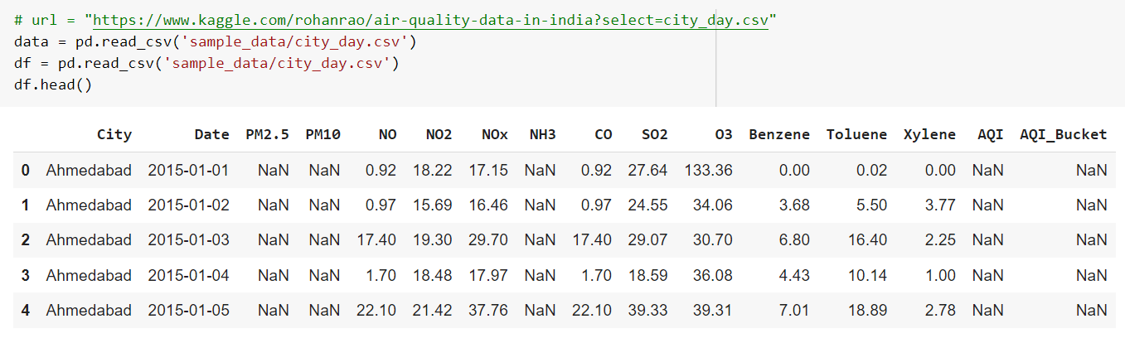
Loading Dataset
Here we can see Nan values which will be handled later.

Slide 9
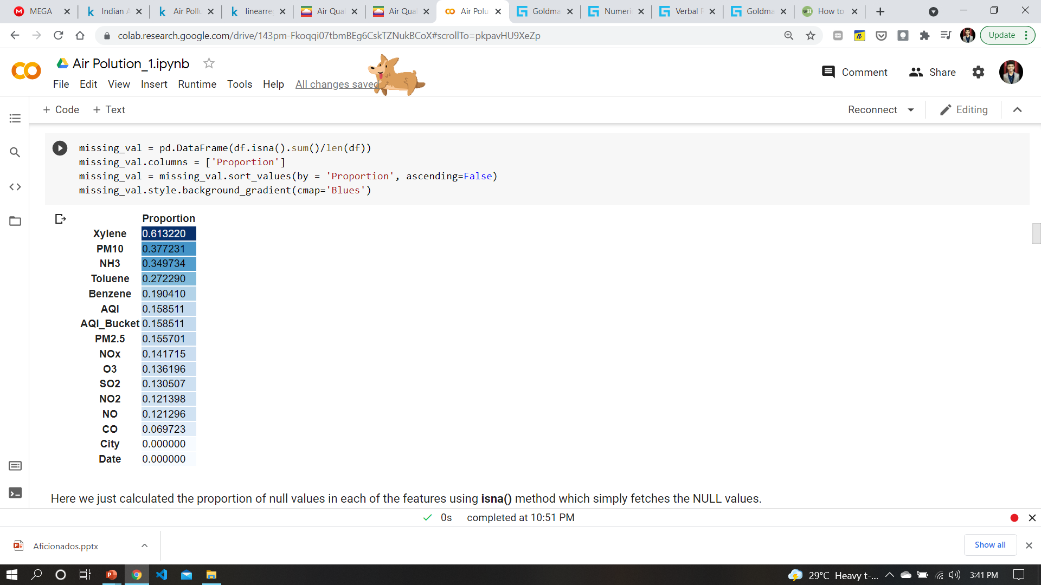
Looking at proportions of null values in columns
Here we just calculated the proportion of the null values in each of the features using isna() method which simply fetches the NULL values.

Slide 10
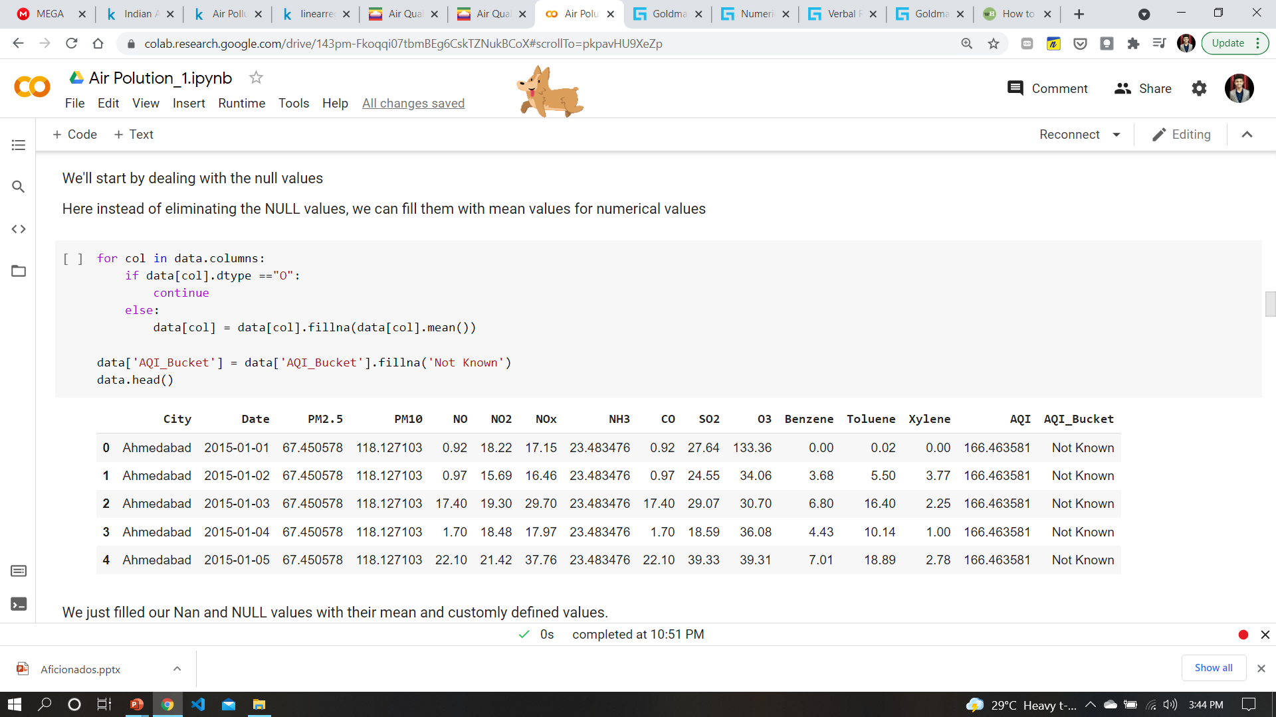
Null Values Elimination
We’ll start by dealing with null values
Here instead of eliminating the Null values, we can fill them with mean values in numerical features

Slide 11
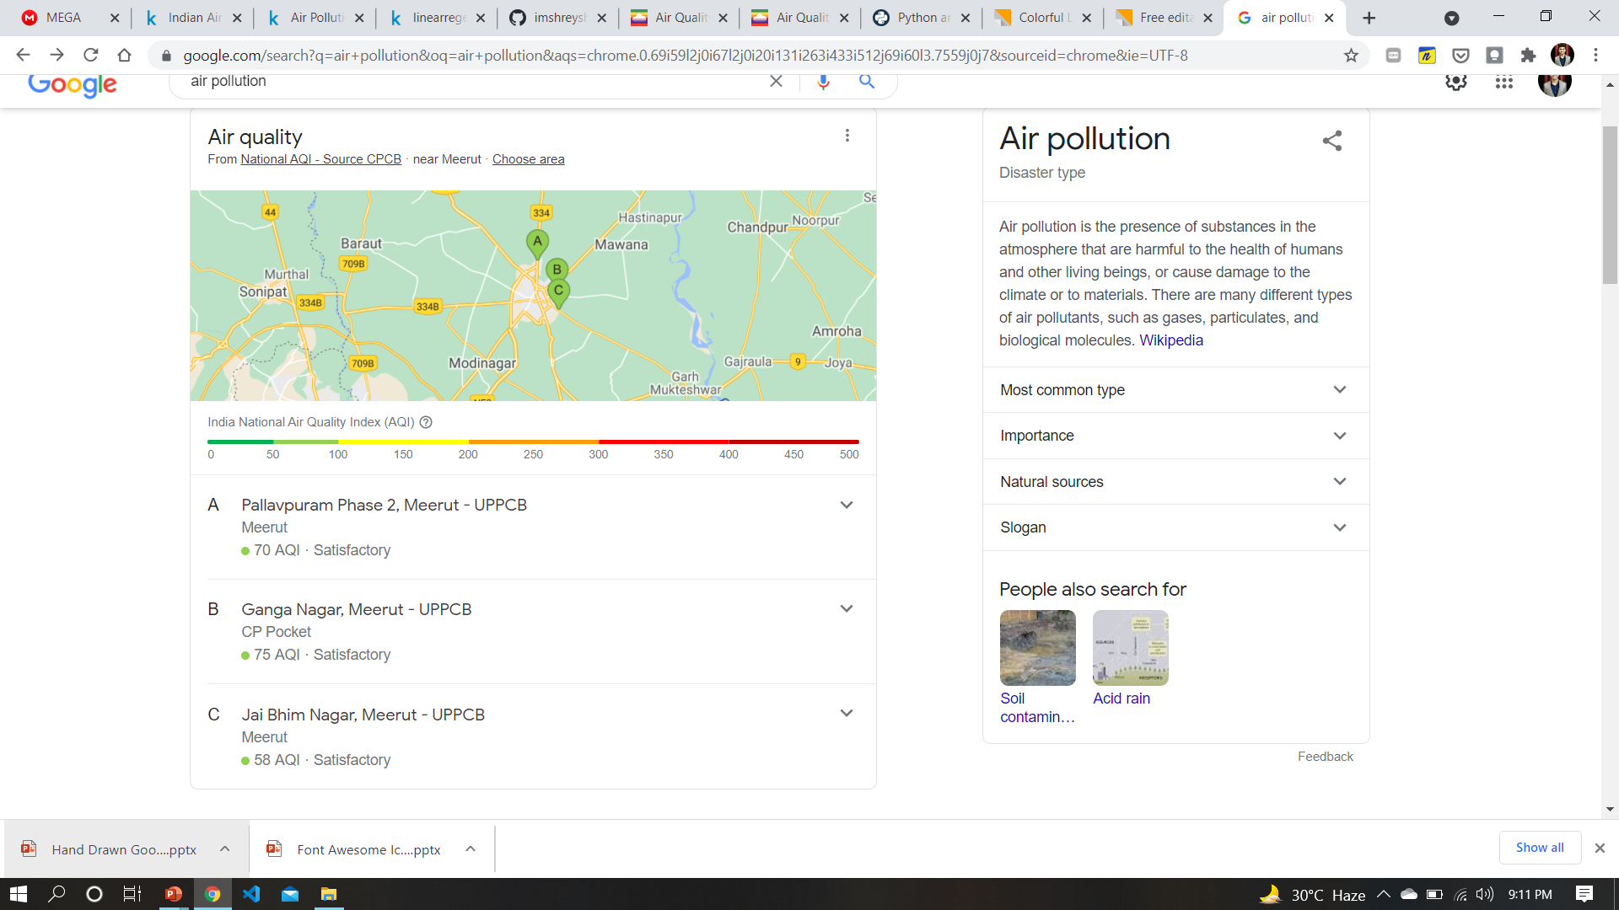
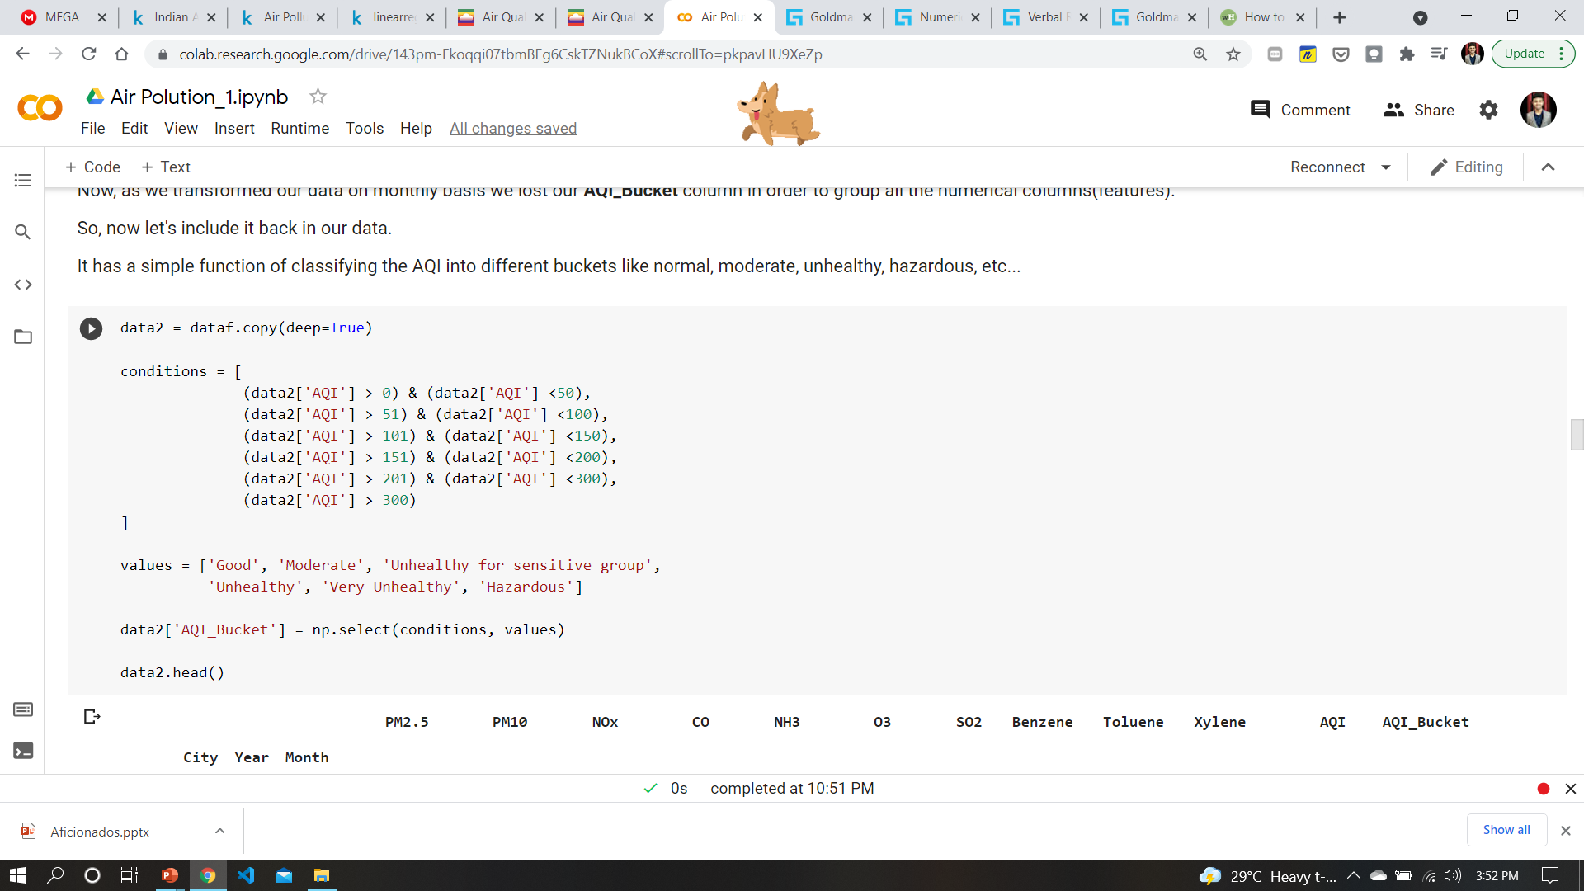
Categorization into different aqi buckets
As we transformed our data on monthly basis we lost our AQI_Bucket column in order to group all the numerical columns(features).
So, we have included it back in our data.
It has a simple function of classifying the AQI into different buckets like normal, moderate, unhealthy , hazardous, etc..

Slide 12
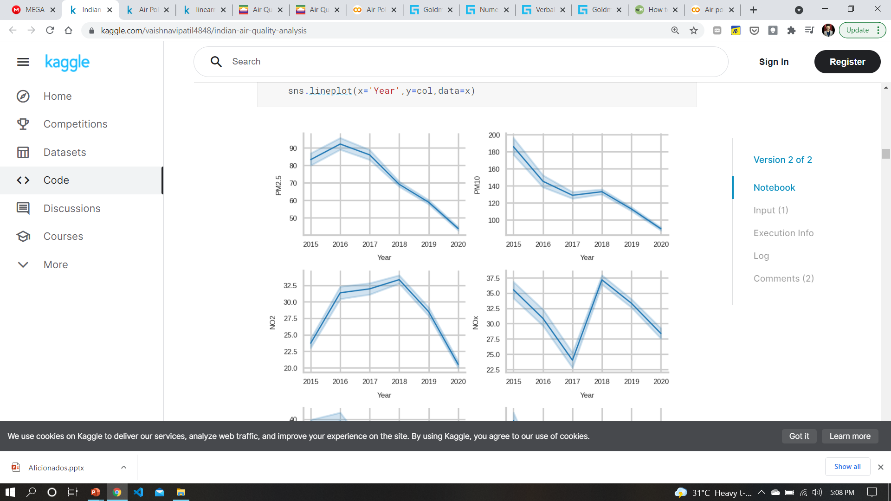
Time for some Time-Analysis
PM2.5 year-wise
We can see the fall in the values PM2.5 as time increases on the x-axis
PM10 year-wise
Here also the trends show a gradual depletion in levels

Slide 13
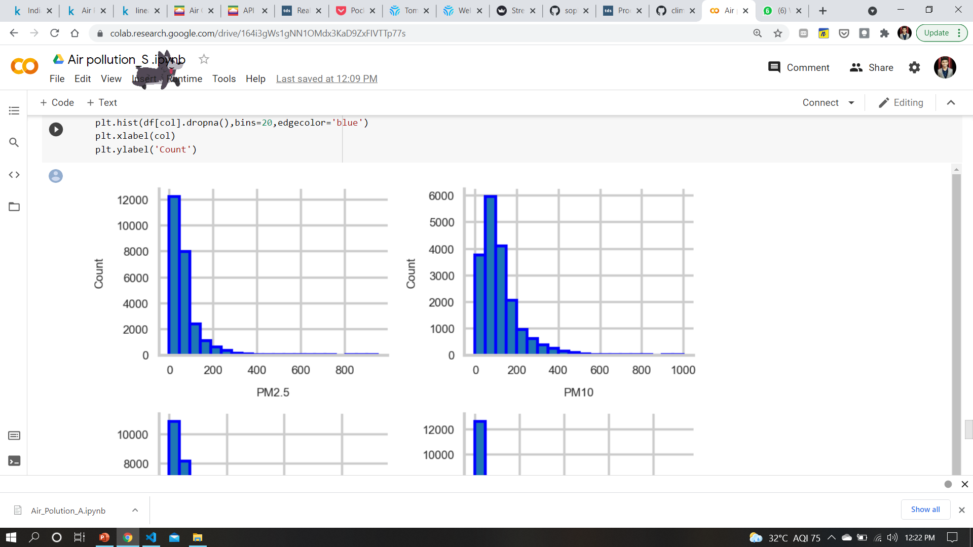
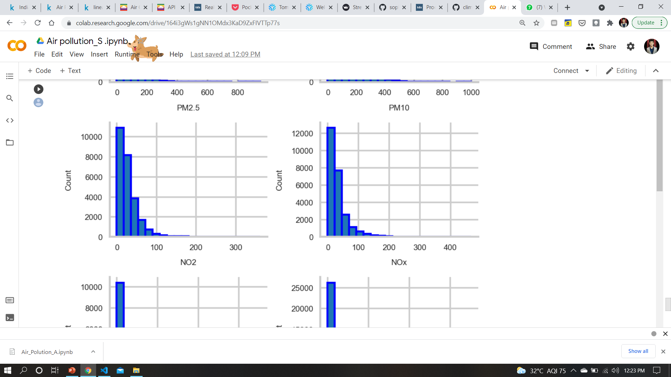
Facts about our features
PM2.5
Here few things are common in all three plots:
All the values lie between 0-200 except PM2.5
Range of counts for values < 100 varies in 10000s which is a healthy sign i.e mode of the distribution is centered around 50s in each.
NO2
NOx

Slide 14
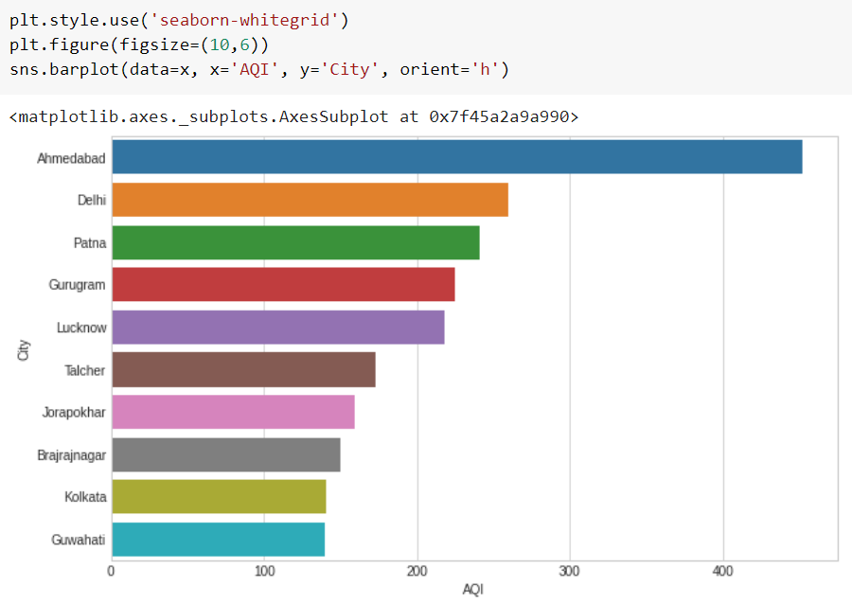
Top 10 cities with highest average AQI

Slide 15
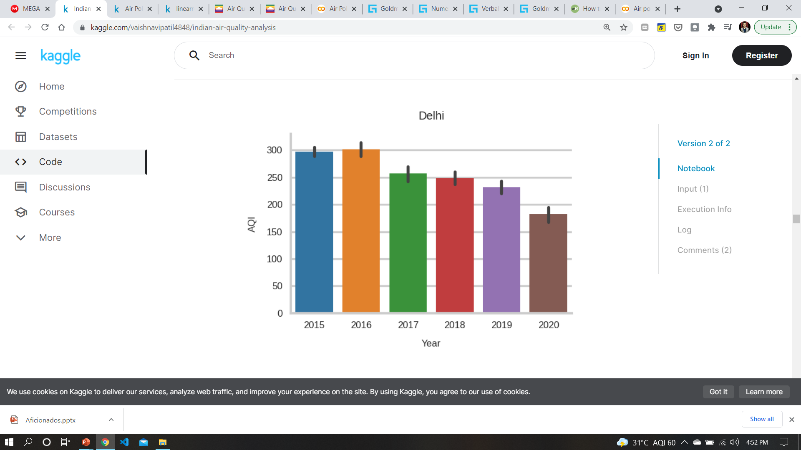
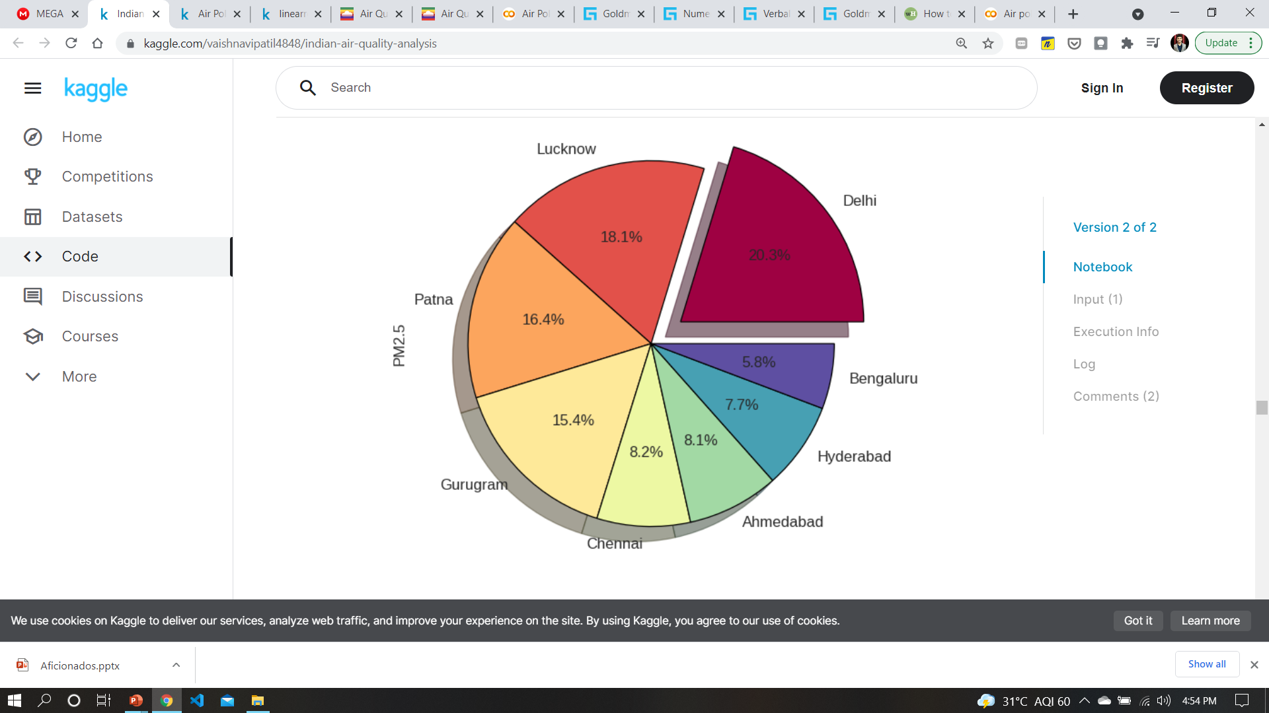
Some more plots of analysis
← Points to be mentioned here are:
Delhi is making progress over years as we can see by decreasing levels of AQI
Though the percentage progress is nice as per the plots, still the levels are in slight severity(i.e. above 175)
Delhi AQI over years
Here we can note some points →
Delhi shares the biggest pie making it most polluted
All the cities are capital regions which infers the respective other factors(like lifestyle, population, etc.) showing this trends
PM2.5 City-wise

Slide 16
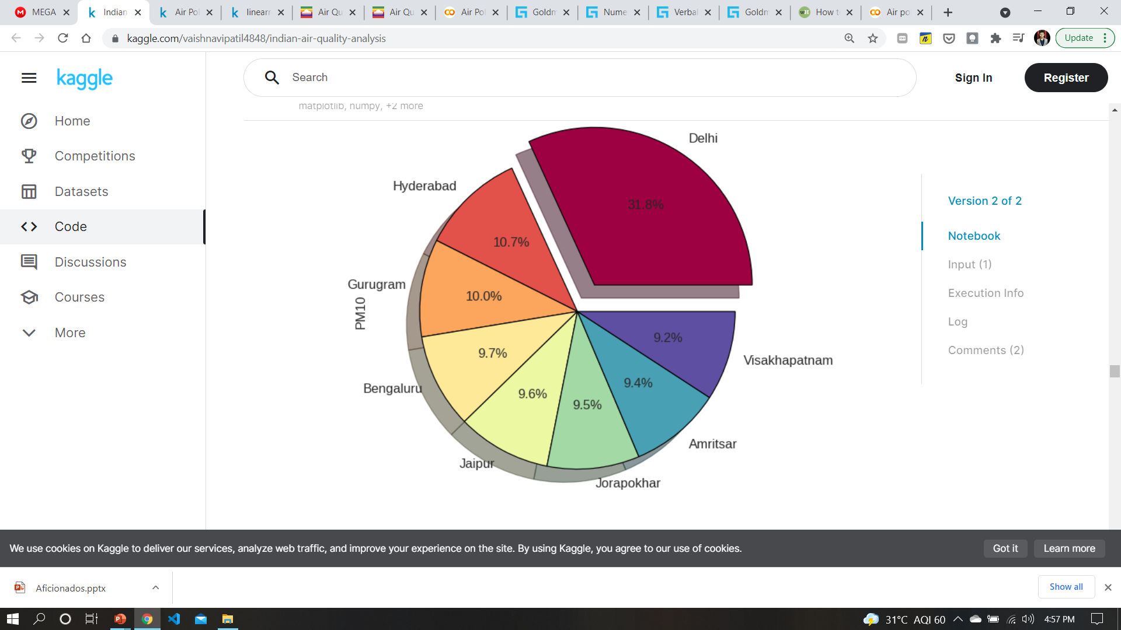
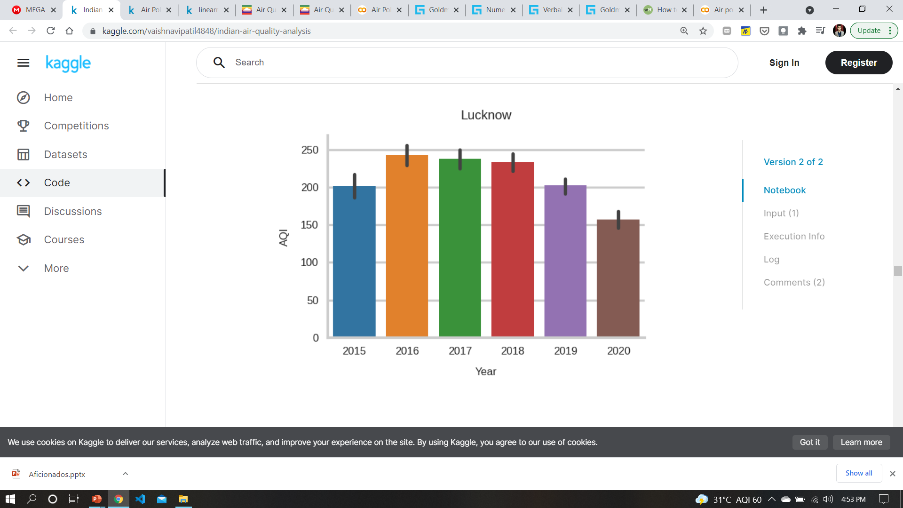
Some more to show…
PM10 City-wise
← Delhi on Top
AQI
Highest from 2016-2018
→
Lucknow AQI over years

Slide 17
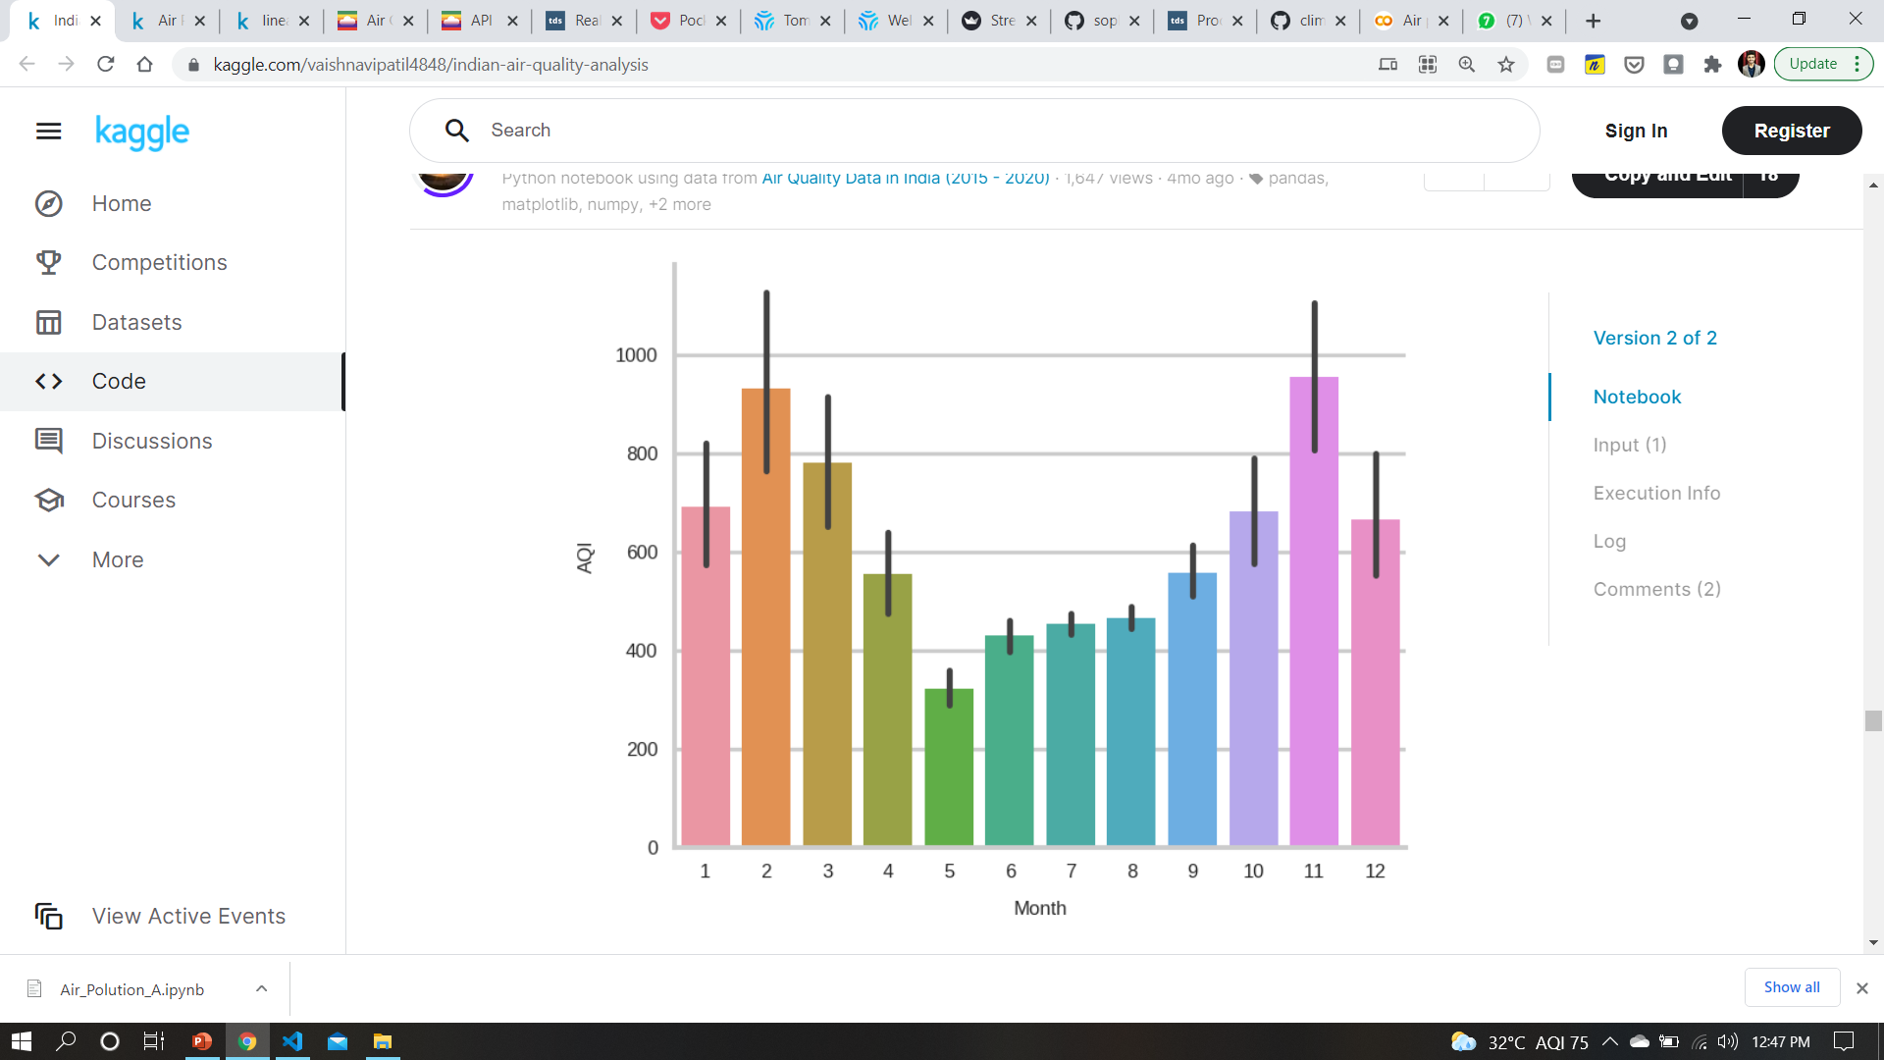
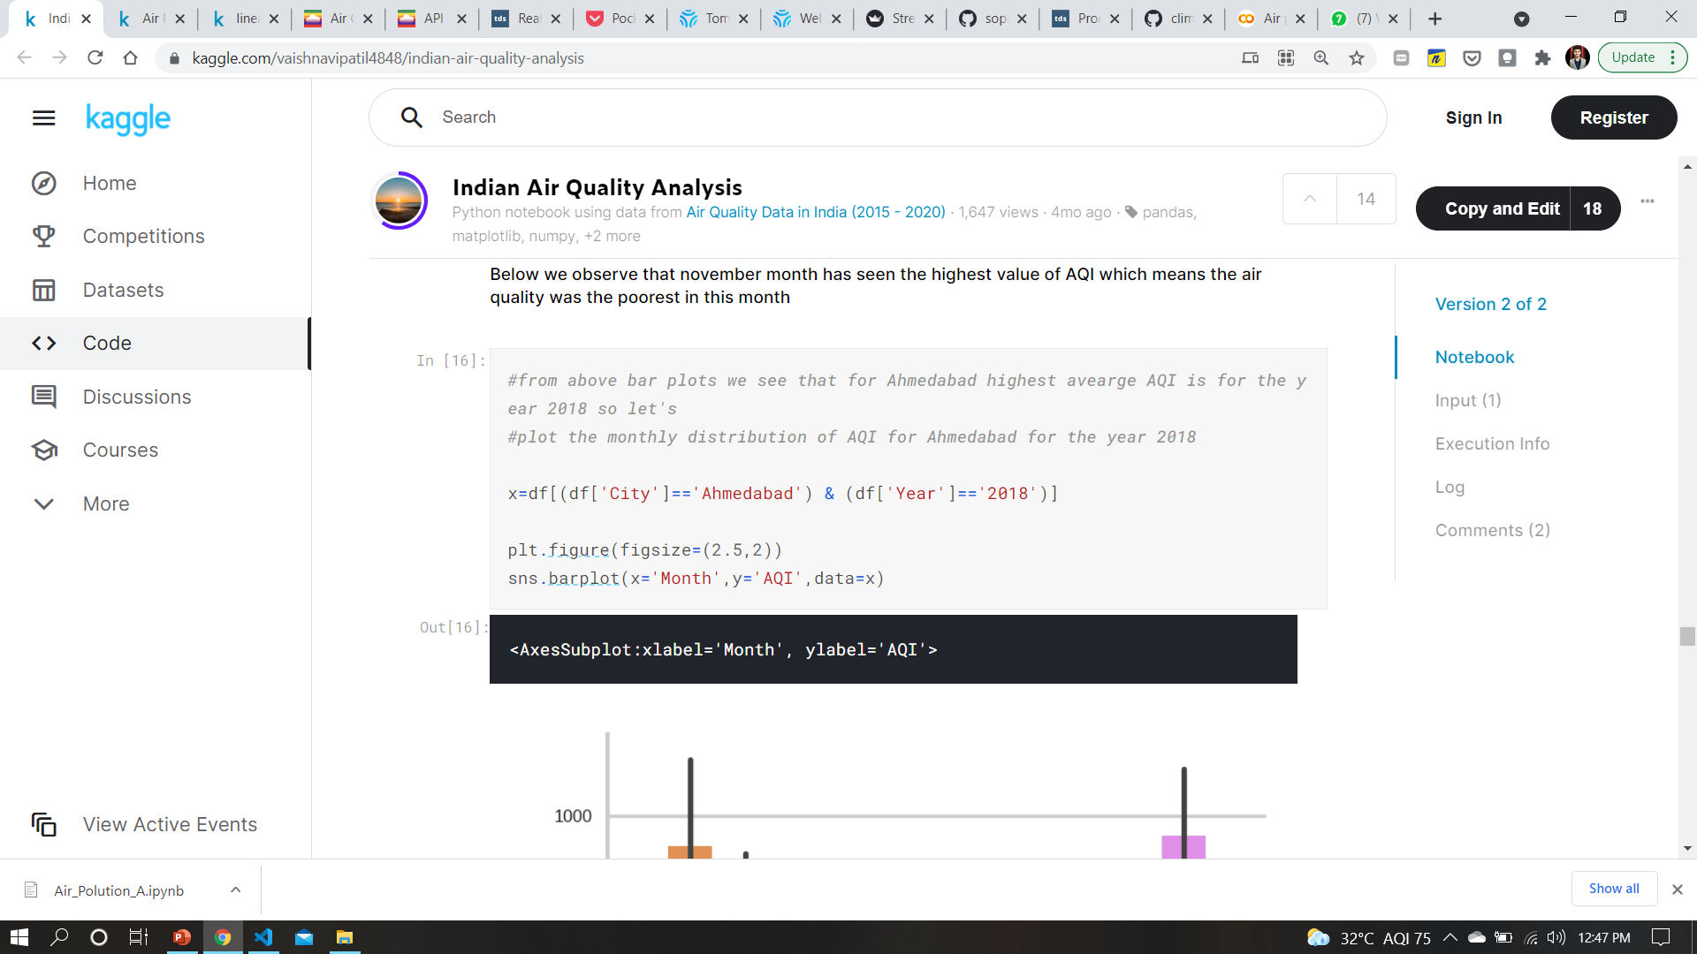
Monthly Aqi values
It is showing how aqi values varies monthly for Ahmedabad in 2018
Like this we can see for other cities too…

Slide 18
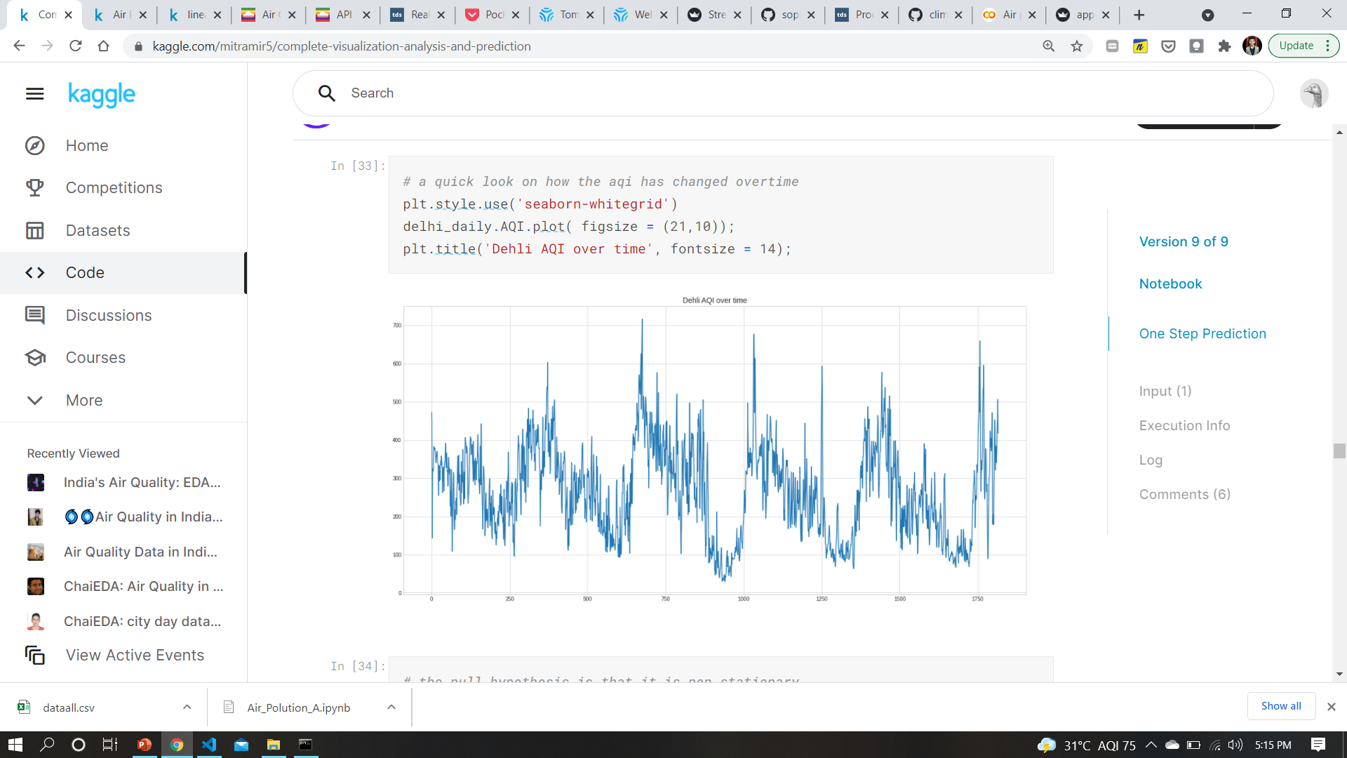
Delhi aqi over time
X-axis: No of days
Y-axis: aqi value
You can see the ups and downs in
the values as time goes on x-axis

Slide 19
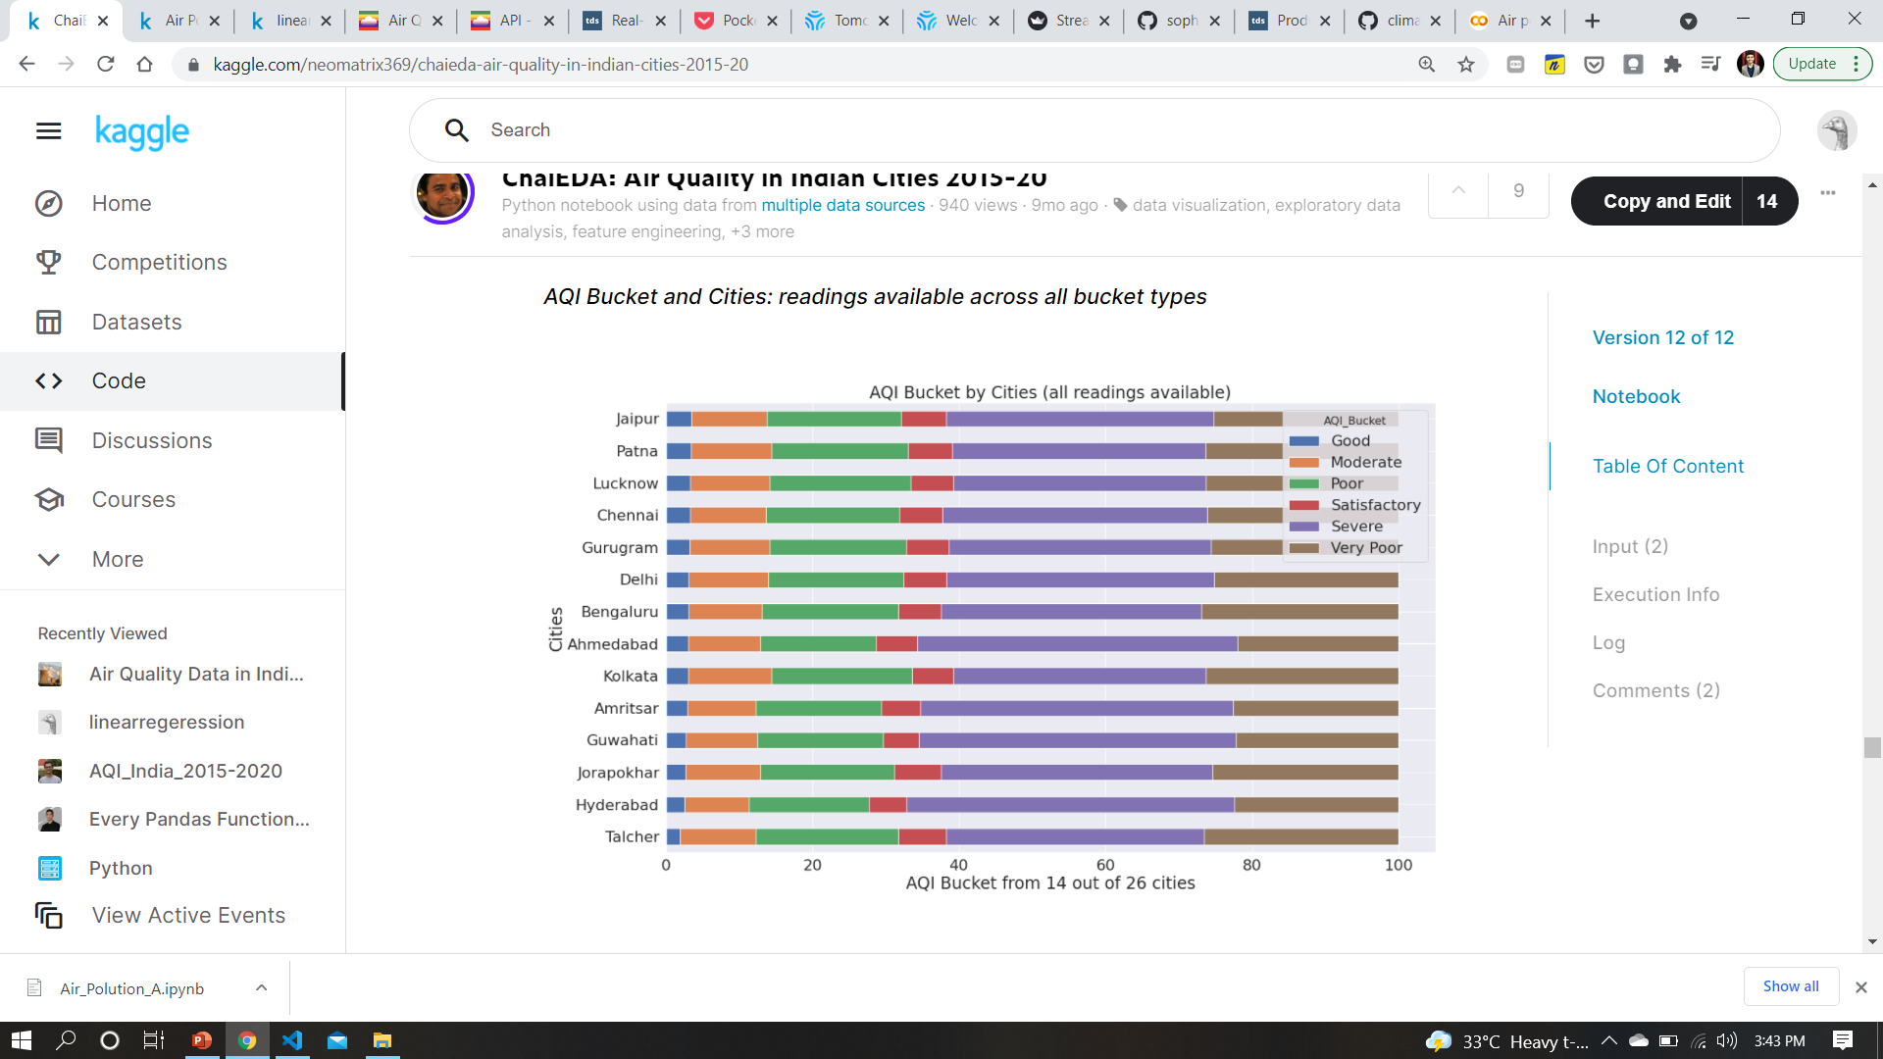
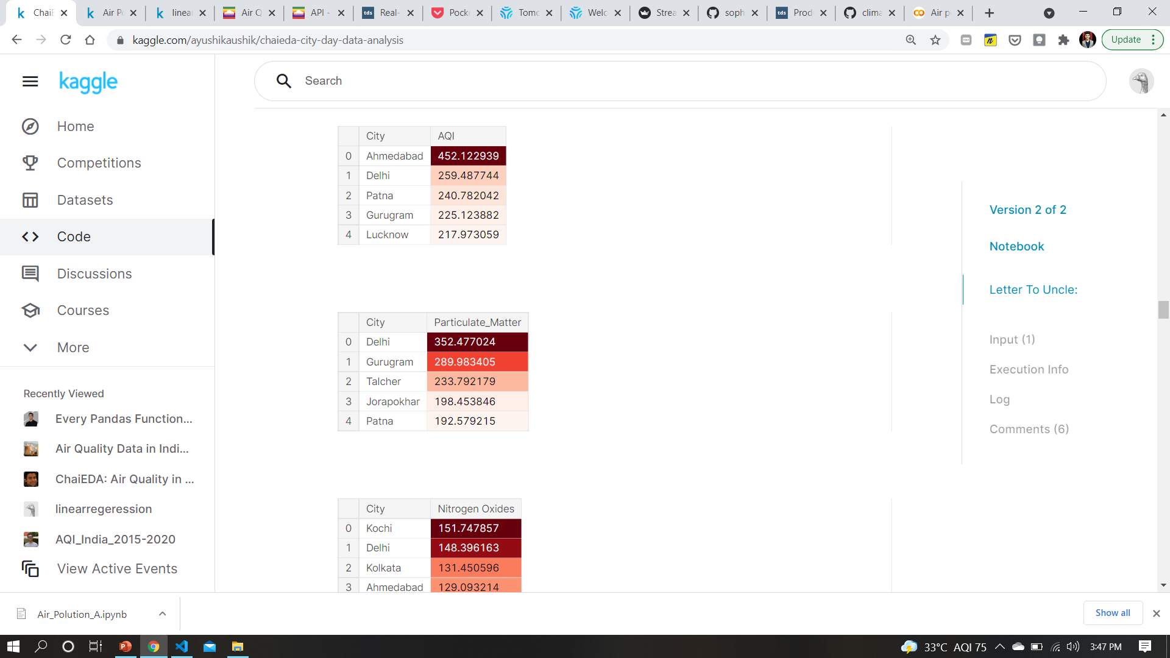
Aqi buckets city-wise

Slide 20
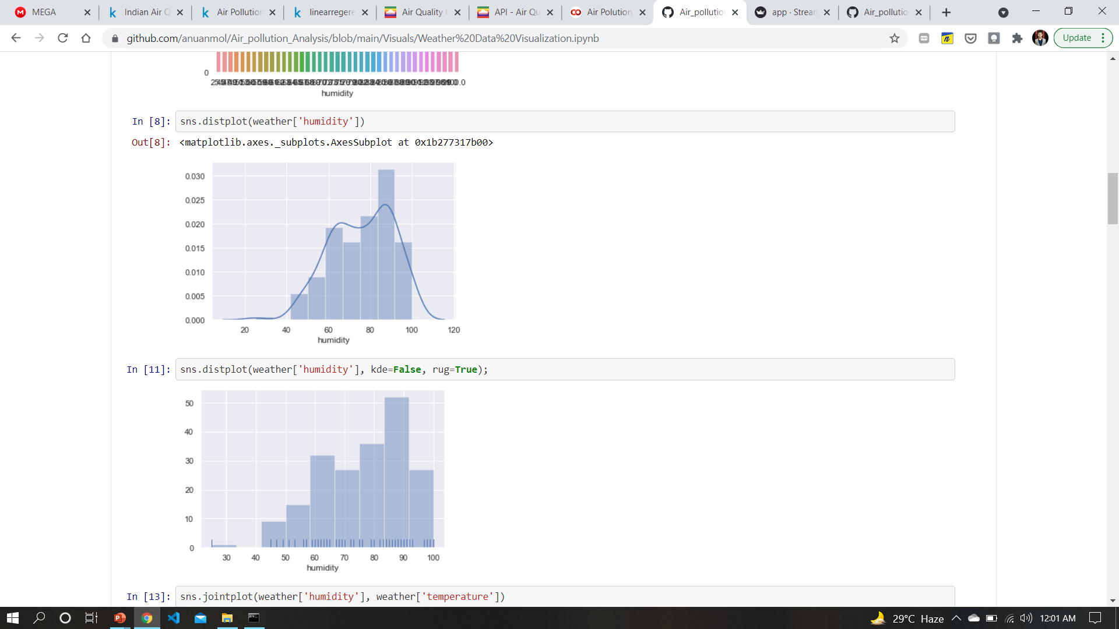
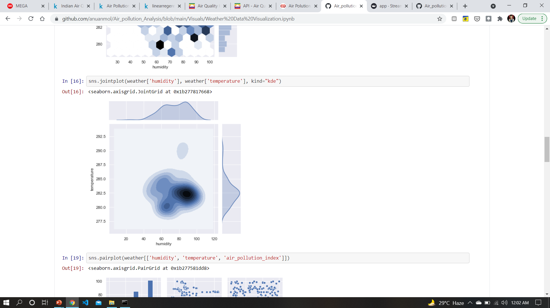
Some Analysis of Metrological data
How Humidity effects Temperature?
Data distribution for Humidity
It shows
Most data points fall under moderate to high humidity
Max density between 70-100

Slide 21
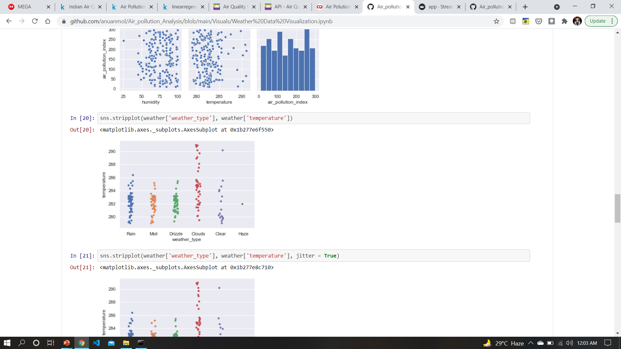
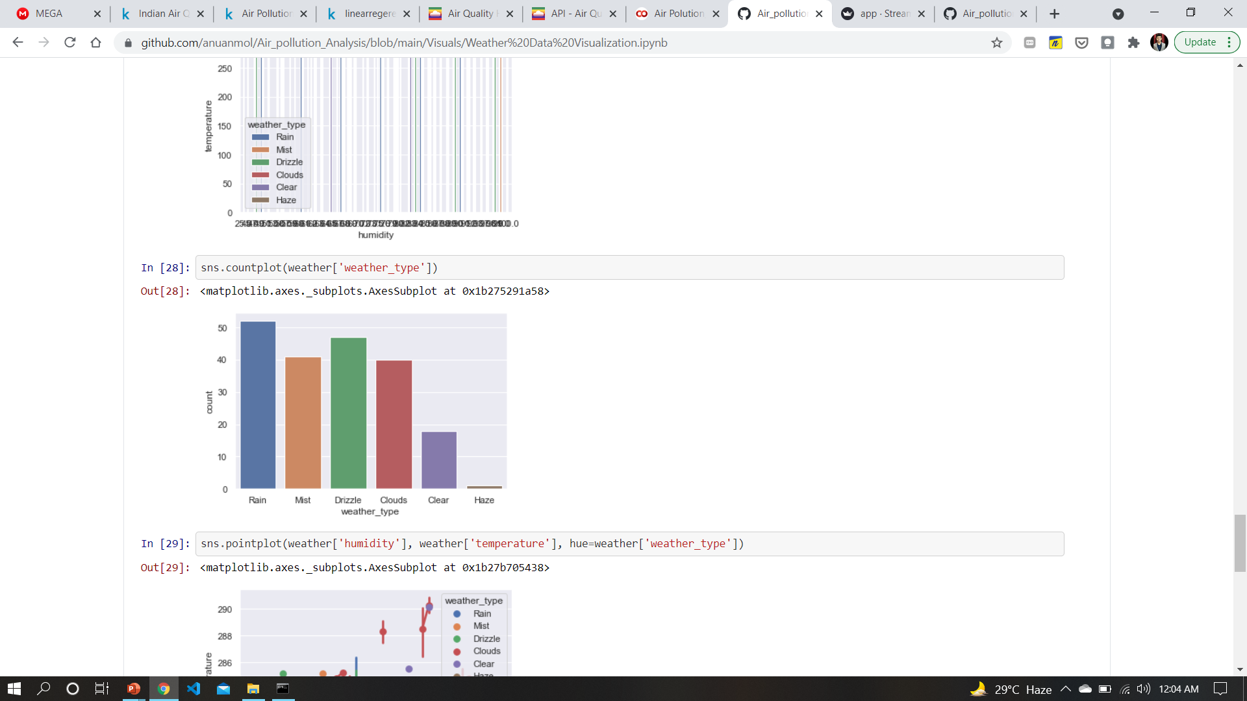
Plots of weather conditions
Air pollution is largely affected by weather conditions like, windy conditions on a particular day can effect air quality in a much rapid way as compared to rainy day.

Slide 22
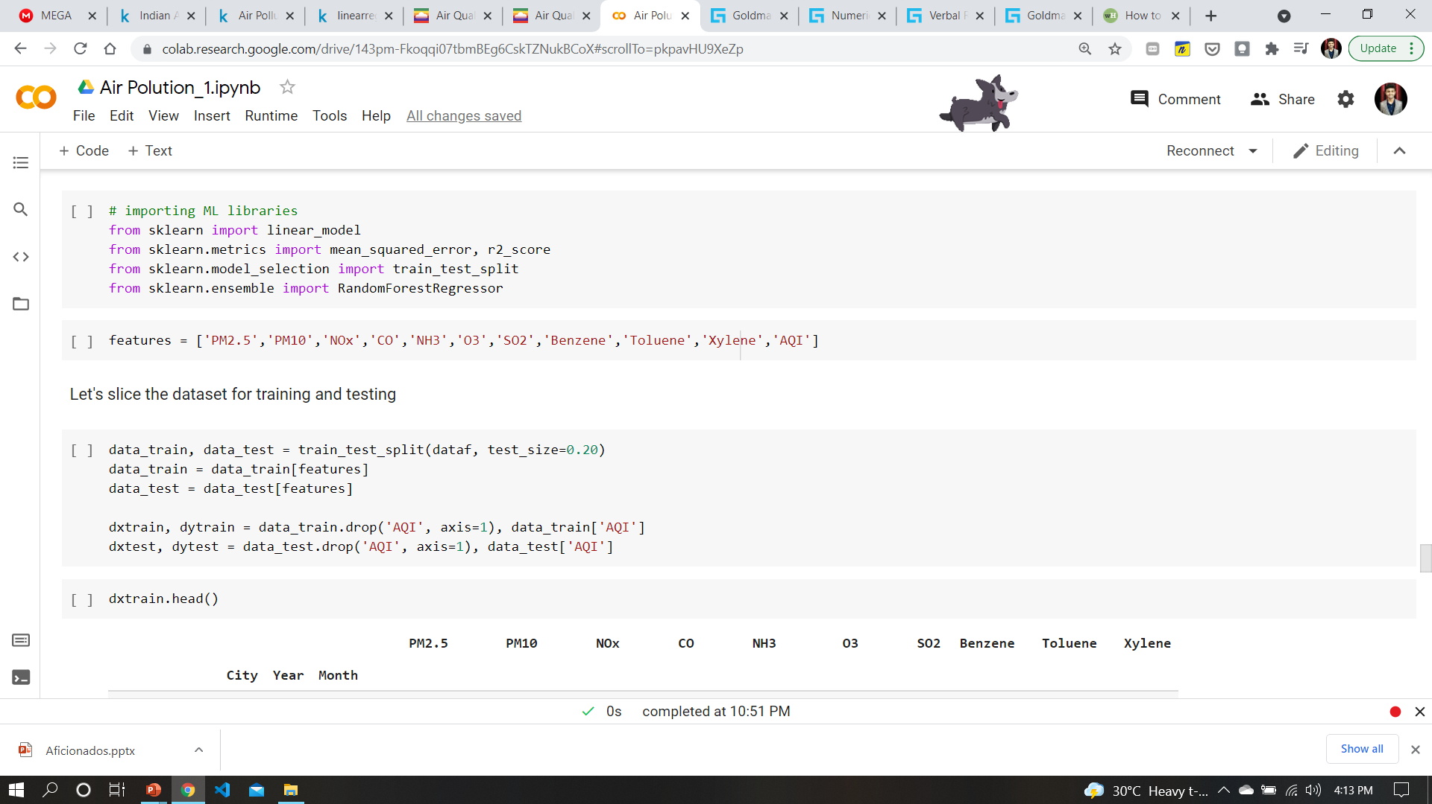
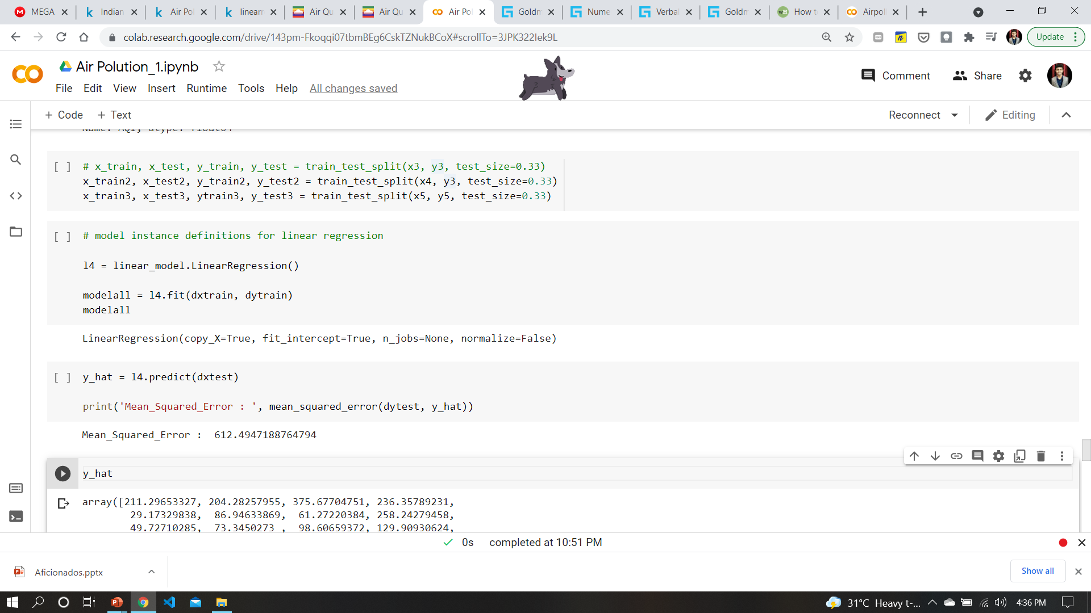
HERE comes the ML part
Necessary libraries
Slicing, Splitting data
Model instantiation
training
prediction
testing

Slide 23
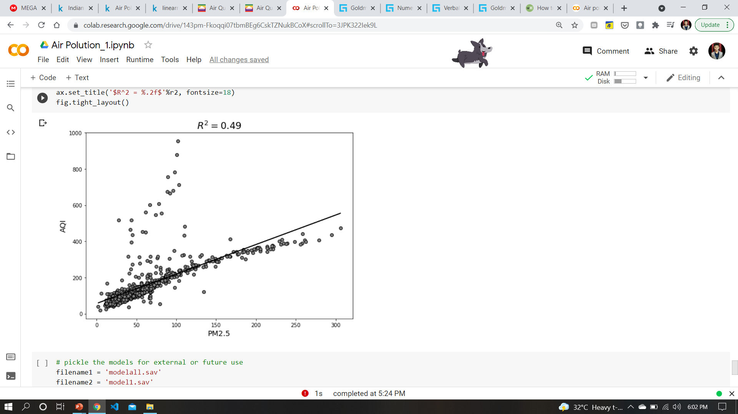
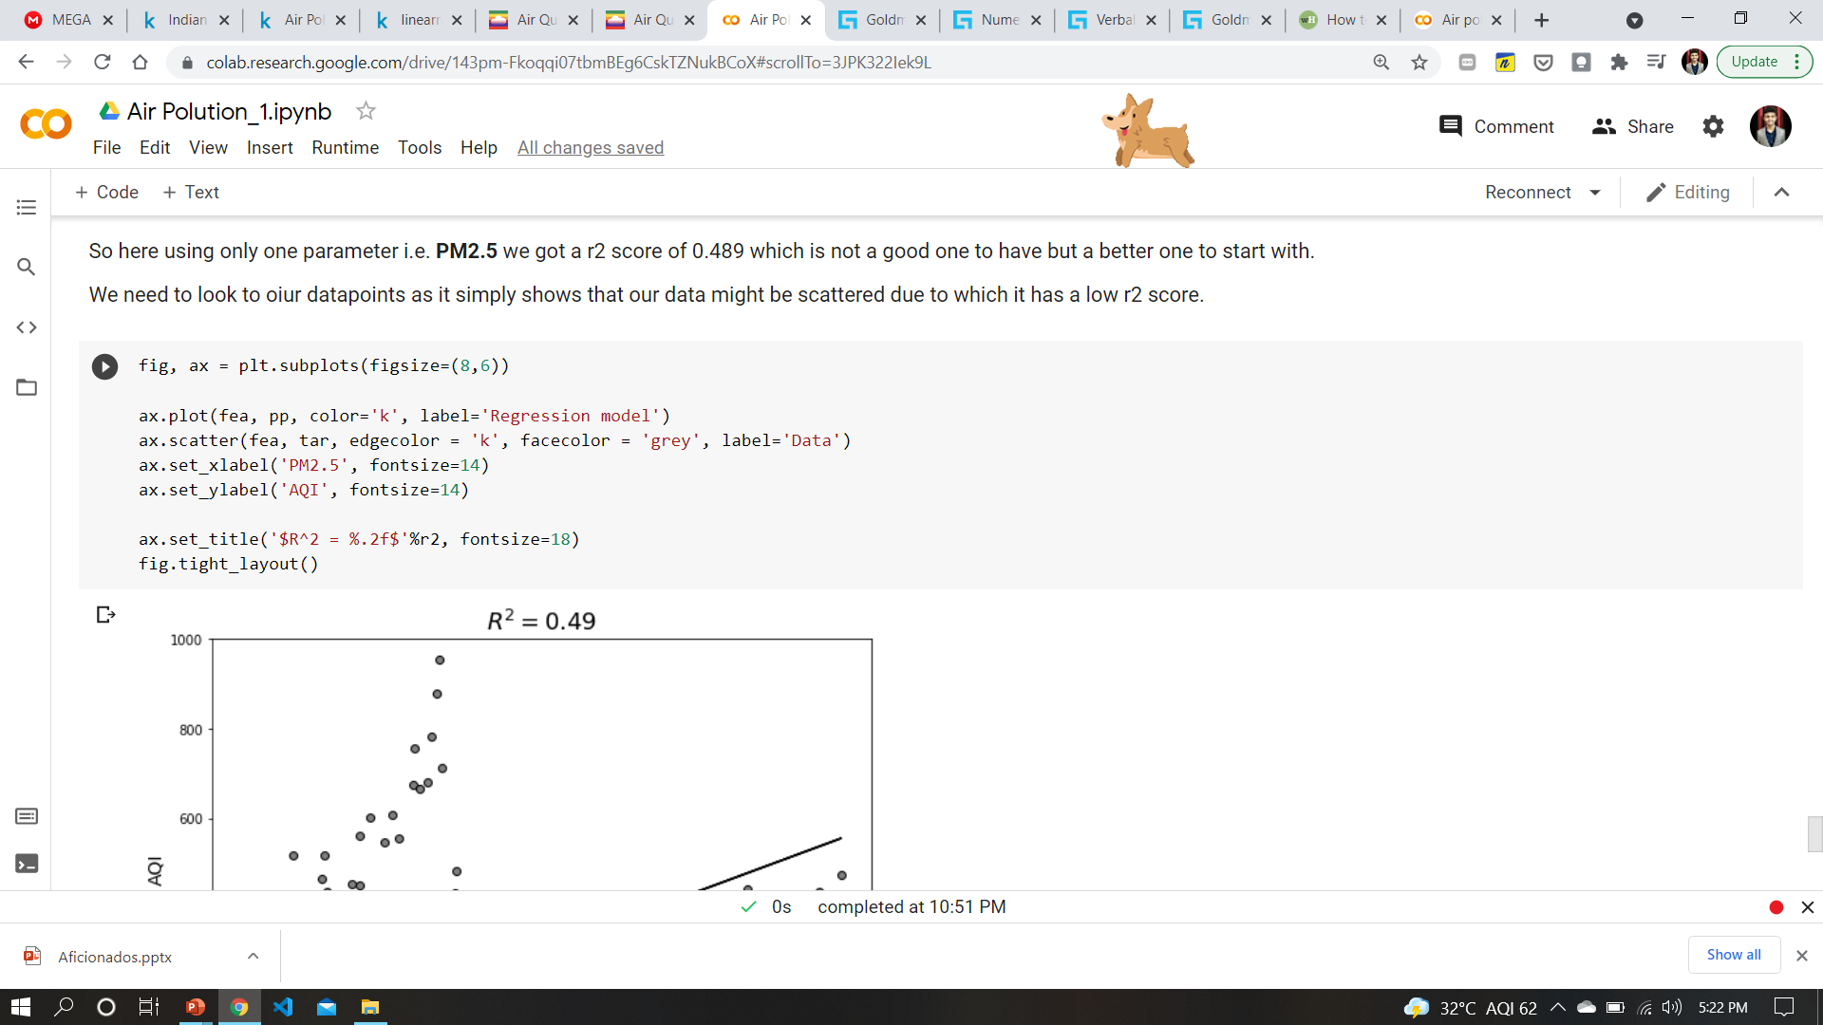
Let’s look at the Metric

Slide 24
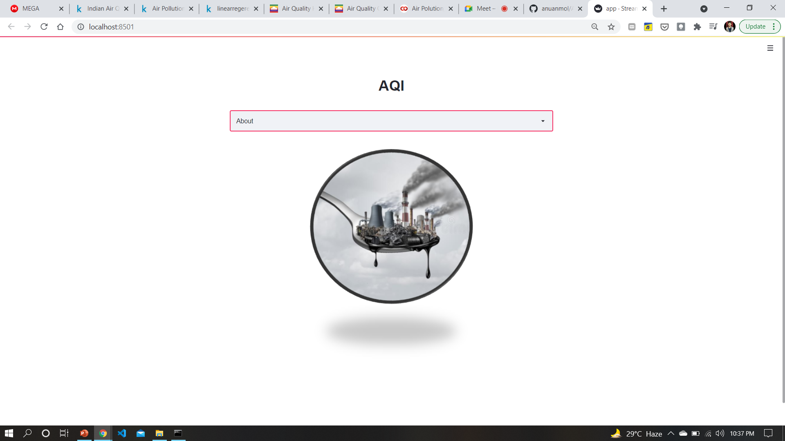
Desktop project
It’ll be the front end for rest of the world.
A reminder!

Slide 25
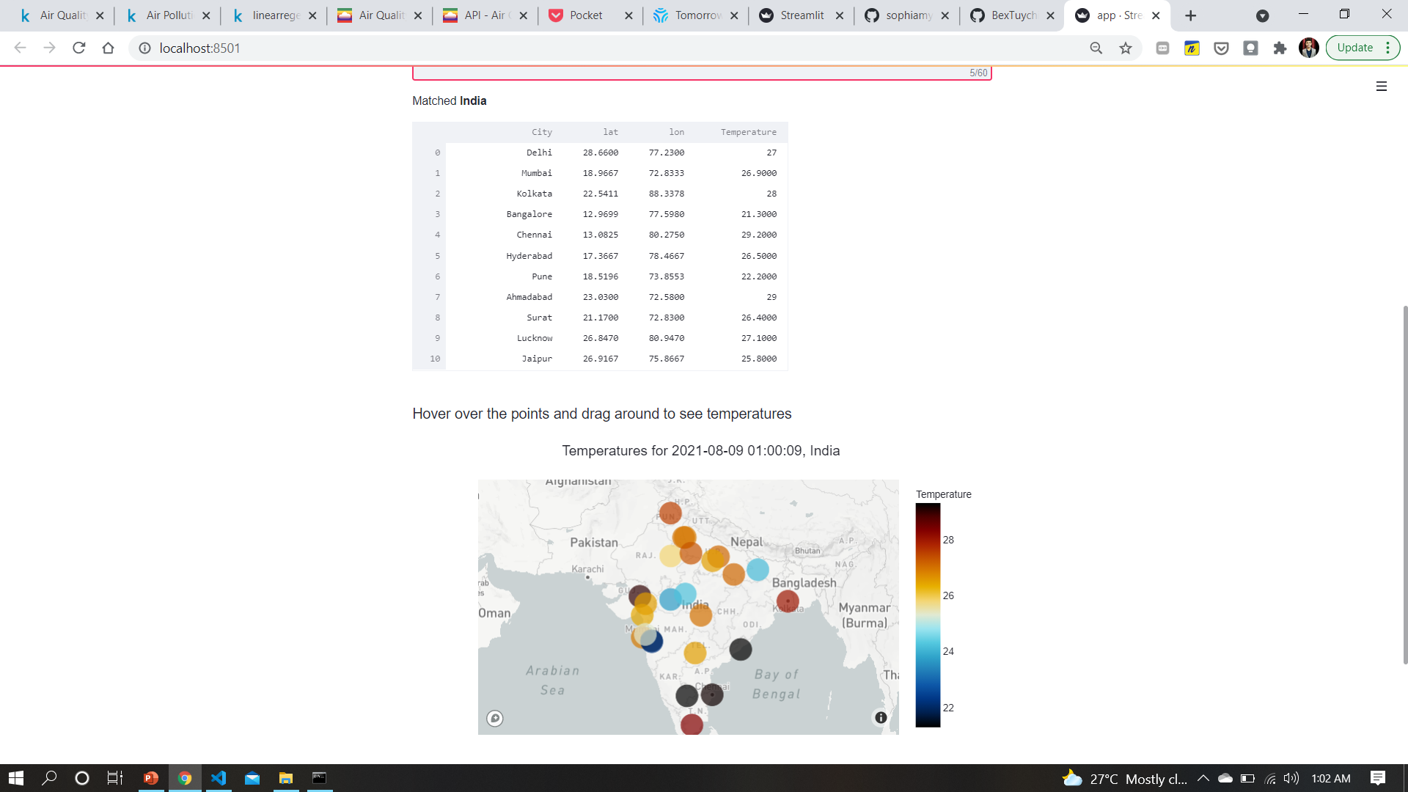
See the air and weather around yourself
Check it out live here →

Slide 26
Insights
Some of the insights from our analysis are:
AQI is mostly affected by few of the features like pm2.5, pm10, co, no, so2
Mostly capital cities have worse air quality as compared to small towns
When aqi is high, temperature also rises
Overs past 5 years average aqi value for some cities has decreased a bit, which is a healthy sign
Still for most of the cities, average aqi values rise every year in a particular season
Weather also plays an important role in defining air quality at any place
You can check our work here:Src1 src2 src3

Slide 27
Overcoming the challenges : Solution
Making strict rules on the use of Electrostatic precipitators
We can try a new alternate to existing fuels like petrol, diesel i.e. [calcium carbide + water], WHICH CAN YIELD ACETYLENE GAS WHICH IS HIGHLY FLAMMABLE WITH LOW CARBON EMISSION
Good public transportation would encourage people to use them
Increase independence from fossil fuels
Afforestation and green muffler, using renewable sources of energy

Slide 28
Some more hidden insights
while it may appear cities with bigger AQi issues might be important, they could also be expensive and technically or politically hard to implement
bigger cities are harder to change and keep up with and the lessons are not learnt easily for a long time
while smaller cities maybe be relatively easier to guide and bring them up to speed and discipline, and these might spread the word to neighboring cities and towns and help foster better well-being in those areas

Slide 29
Credits
Special thanks to all the people who made and released these awesome resources for free:
https://www.kaggle.com/anvithashet/linearregeression
https://aqicn.org/data-platform/register/
https://towardsdatascience.com/real-time-dashboard-in-python-970e3c32b3d7
https://www.kaggle.com/vaishnavipatil4848/indian-air-quality-analysis
And our Mentor Mr. Abhishek Ratnakar Singh sir for his constant guidance and support.

Slide 30
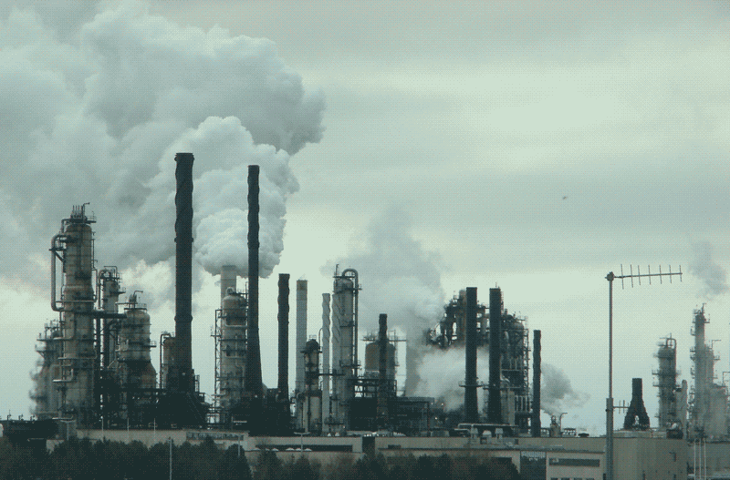
Thanks!
Any questions? You can find us at:
@github:anuanmol

